Slide 1
Montgomery Bus Boycott Standard:11.10.2 Examine and analyze they key events, policies, and court cases in the evolution of Civil Rights
1955-1956

Slide 2
Warm Up
After reading the following passage, write down in your journals at least 1/2 page response explaining your reaction. Do you feel as though you would set aside your daily schedules to fight for a cause you believed in? Give evidence.
“Another Negro woman has been arrested and thrown in jail because she refused to get up out of her seat on the bus for a white person to sit down. This has to be stopped. Negroes have rights, too, for if Negroes did not ride the buses, they could not operate. If we do not do something to stop these arrests, they will continue. The next time it may be you, or your daughter, or mother. We are, therefore, asking every Negro to stay off the buses Monday in protest of the arrest and trial. Don’t ride the buses to work, to town, to school, or anywhere on Monday. You can afford to stay out of school for one day if you have no other way to go except by bus. You can also afford to stay out of town for one day. If you work, take a cab, or walk. But please, children and grown-ups, don’t ride the bus at all on Monday. Please stay off all buses Monday.”

Slide 3
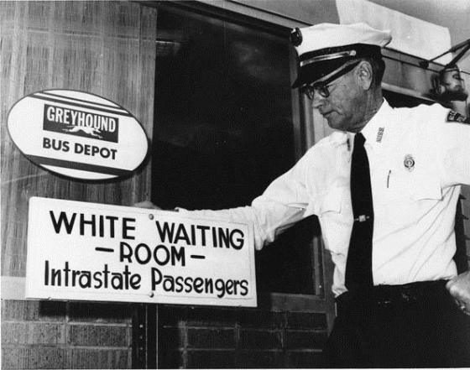
Background
Jim Crow Laws: Separate the races (common in the South)
Brown Vs. Board of Education occurred a year before the boycott
Decision applied to public transportation as well

Slide 4
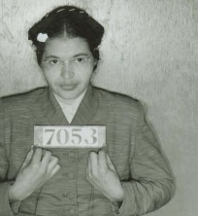
Start of The Modern Civil rights Movement
December 1st 1955 Rosa Parks refused to give up her seat
17,000 blacks initially took part in the boycott
Freedom Carpools
Not just black citizens involved

Slide 5
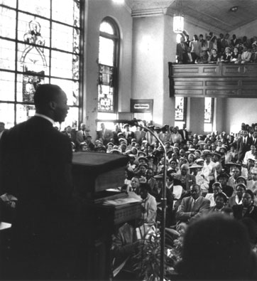
Martin Luther King’s Involvement
Non-Violent approach (discuss Effects)
Reaction from whites and blacks
Elected President of the Montgomery Improvement Association

Slide 6
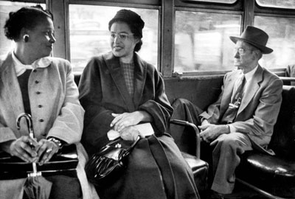
Final Outcome
New Leaders emerged
Instigated other forms of protests (freedom rides)
381 day boycott ended
Supreme Court ruling to desegregate Montgomery buses
Did not just effect Montgomery citizens

Slide 7
Video Clip
Video Clip: http://www.teachertube.com/viewVideo.php?video_id=94826

Slide 8
In Class Activity
I will assign groups of 5-6 people
Each group will be given a handout with a biography of one of the 6 influential leaders from the Boycott
Each group will then create a poster and answer questions on the person assigned to your group
Each individual in the group will be responsible for filling out their own worksheet that has the questions on it
You will have to complete the readings from the biography to answer the questions (If need assistance, use your book for further information)
Draw a picture of the person your group is presenting on poster paper (use markers to make the picture stand out and put any artifacts that represent your group’s person)
Each group will present their poster (pay attention to your class mates because you will need to fill in their biography information on the worksheet given to you)

Slide 9
Example
Person: Rev. Ralph David Abernathy
1.How Were they Significant in the Bus Boycott: Vocal against segregated buses and the treatment of blacks in the Capital City
2. How did he/she impact the Civil rights Movement :He became a pastor for the first Baptist Church in Montgomery where he preached about Civil Rights. Rev.
3. Did they use a violent or non Violent approach (or did they condone a violent or non-violent approach): Rev. Ralph condoned a non violent approach, which he advocated for with Martin Luther King
4. How did others react to their actions?: Many people supported Rev. Ralph and his messages he preached at church. People also liked to look up to him because of his leadership in the bus boycott
5. Interesting facts about them?: He served in the Army in World War two. His political activism began in college.

Slide 10
After Activity
-After taking notes on all of the leaders: write down two people you find similar, and two people you find different, and provide an explanation on the back of your worksheet
Please Turn in your worksheet and your groups poster for credit

Slide 11
Assessment
It has been suggested that Rosa Parks sat in the front of the Bus by accident/ because she was tired. After reading/taking notes about the different people involved in the Montgomery Bus Boycott, do you think that it was a planned act for Rosa Parks to Sit in the front of the bus? If you feel that Civil rights leaders and the NAACP planned to have Rosa Parks sit in the front of the bus; why do you believe they planned it, and do you think the plan worked?
Write 3/4 to 1 page answering the question. Please turn in your response at the end of class.

Slide 12
Most Urgent Needs

Slide 13
Reflection
After listening to the lecture/video/presentations, do you feel the Montgomery Bus Boycott had a positive impact on the Civil Rights Movement? Did the information you learned confirm, contest, or further your understanding about the Montgomery Bus Boycott movement? Would you have taken the time to walk to school instead of taking the bus if you knew it was for a good cause?
Please take some time to write your response in your Journal, you may finish the response at home if you run out of time.

